Slide 1
Conditional Text Generation Techniques and Issues
Bran

Slide 2
Content
Introduce
Techniques
Issues
Conclusion

Slide 3
Introduce Conditional Text Generation
At least two people have tested positive for the bird flu virus in eastern turkey , health minister Recep Akdag told a news conference wednesday .
≤5
Two infected with bird flu
6-10
Two infected with bird flu in eastern turkey
> 10
Two people tested positive for bird flu in eastern turkey says minister
Notes:
Summary
The model may predict a summary like this
They are both ok,. But In real life, we may want control the lengths of summaries
Such task is called conditional text generation we have conditions of generated text

Slide 4
Introduce Conditional Text Generation
Task
Condition
Style Transfer
Style
Dialogue response generation
Aspects of responses, such as formality
What may be a condition of story generation?
Story Generation
Ending
……
……

Slide 5
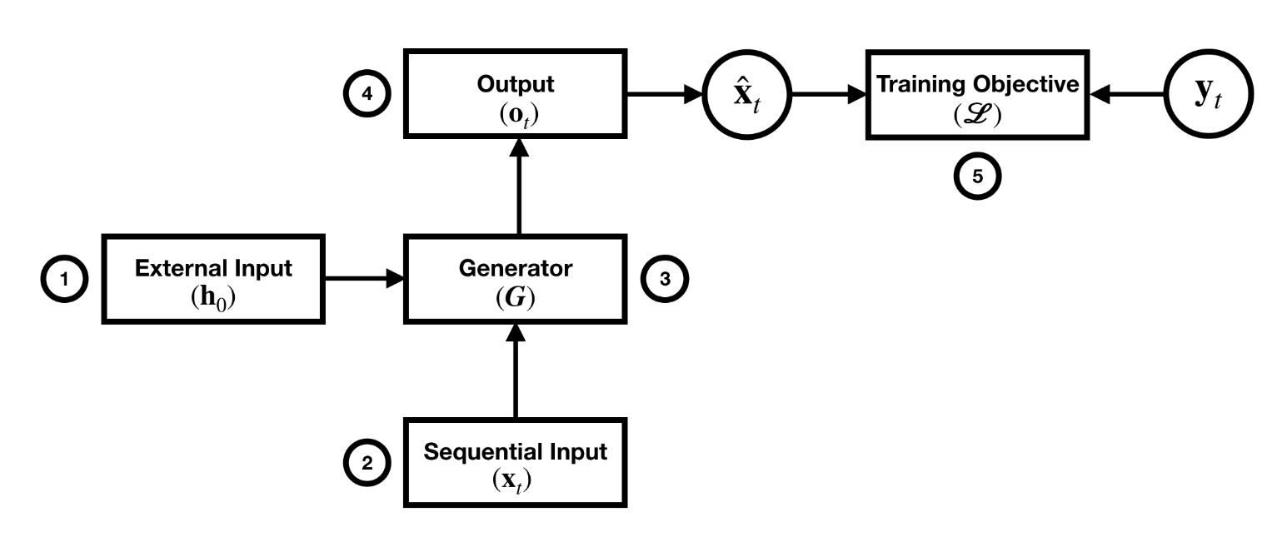
Techniques
X : source sequence
Y: target sequence
S: Condition attributes
Notes:
Modulating these parts to control the generated texts
Talk them one by one

Slide 6
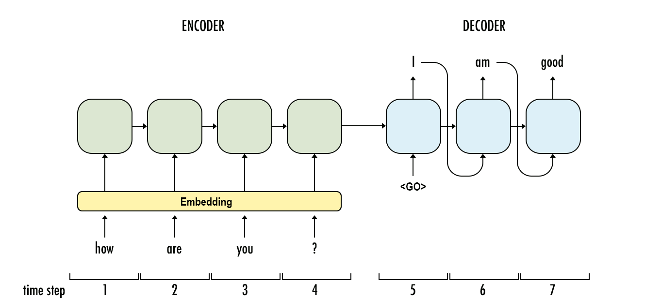


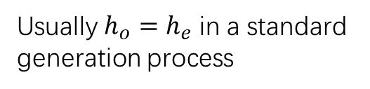
1. External Input
$$h_{e}$$
$$h_{0}$$
Usually $h_{o}=h_{e}$ in a standard generation process
1. Arithmetic or Linear Transform
$$h_{o}={[h}_{e};s]$$
$$h_{o}=h_{e} + s$$
$$h_{o}={tanh⁡(W_{1}h}_{e} + W_{2}s+b)$$
Notes:
Usually h_o is h_e
Experiment shows concatenation technique is better at preserving the meaning of the generated story, the arithmetic operation provides a better signal of the style for the generation process

Slide 7
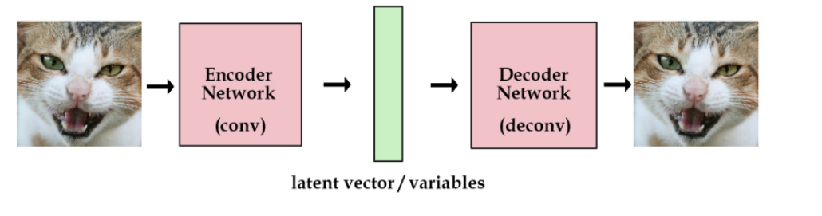
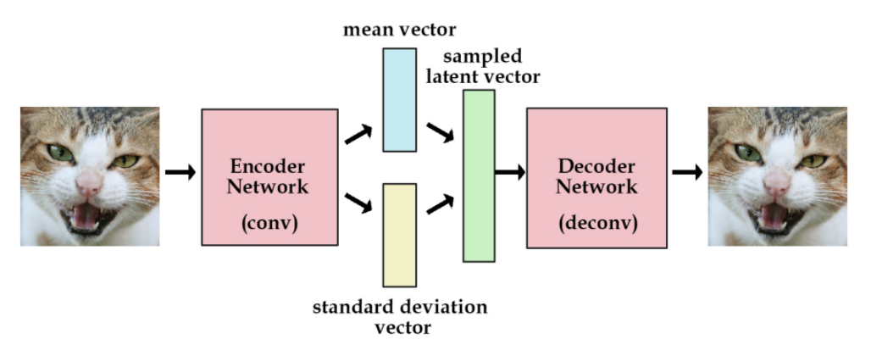
2. Stochastic Changes
We can use Variational Auto- Encoder (VAE) to encode the source and add condition s into laten variable z
Notes:
So many pictures
length

Slide 8
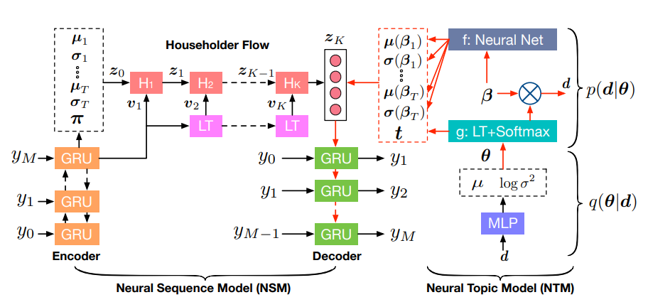
Wang. Et al(2019b), Topic-guided variational auto-encoder for text generation.
Notes:
Mix Gaussian distribution

Slide 9
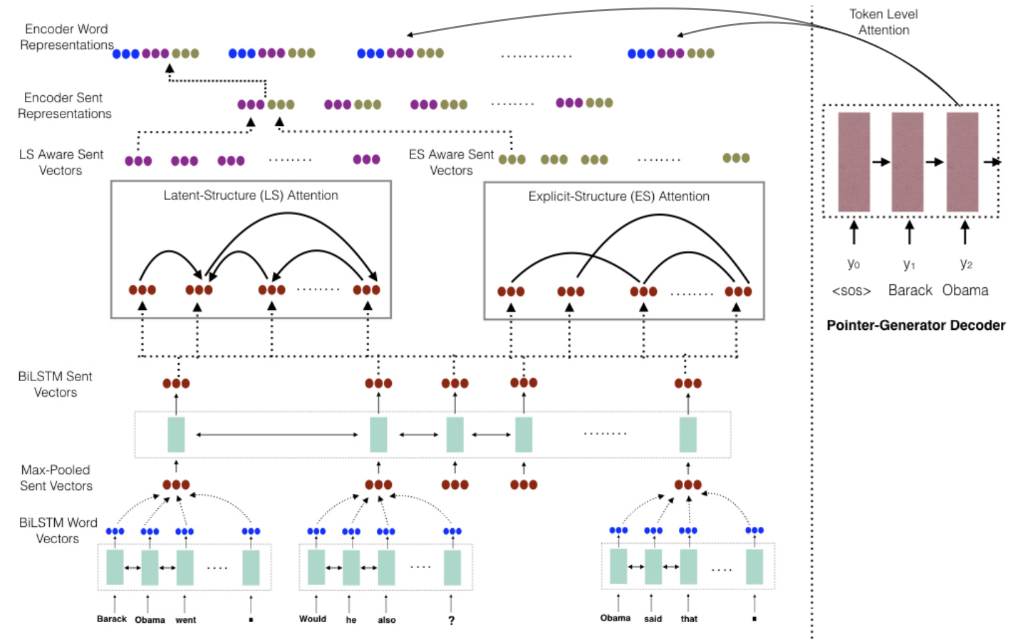
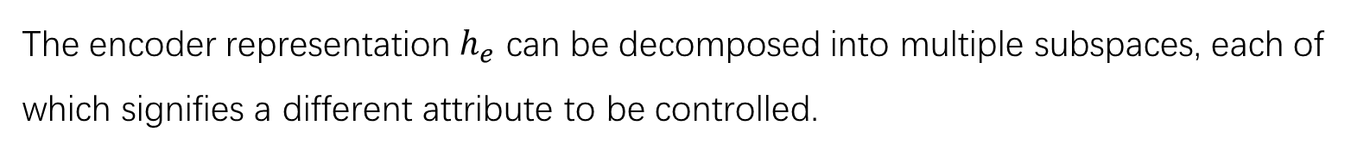
2. Decompose
The encoder representation $h_{e}$ can be decomposed into multiple subspaces, each of which signifies a different attribute to be controlled.

Slide 10
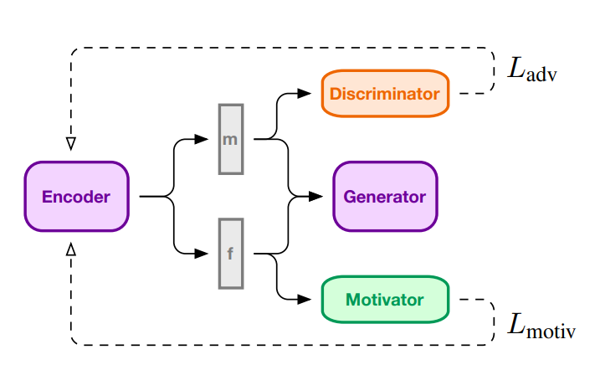
m is the meaning vector
f is the form vector
Notes:
Sentence representation

Slide 11
2. Sequence Input
X : source sequence
Y: target sequence
S: Condition attributes

Slide 12
1. Arithmetic or Linear Transform
$$x_{t}={[x}_{t};s]$$
$$x_{t}=x_{t} + s −S$$
$$x_{t}={tanh⁡(W_{1}x}_{t} + W_{2}s+b)$$

Slide 13
3. Generator
X : source sequence
Y: target sequence
S: Condition attributes
Notes:
This module takes in the external input h0, the sequential input xt at time step t and performs the same set of computations (G) to return an output ot. Changes can be made to the set of operations G to include the the control vector s in computing ot.

Slide 14
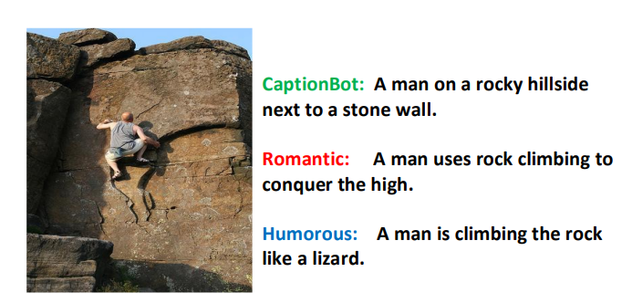
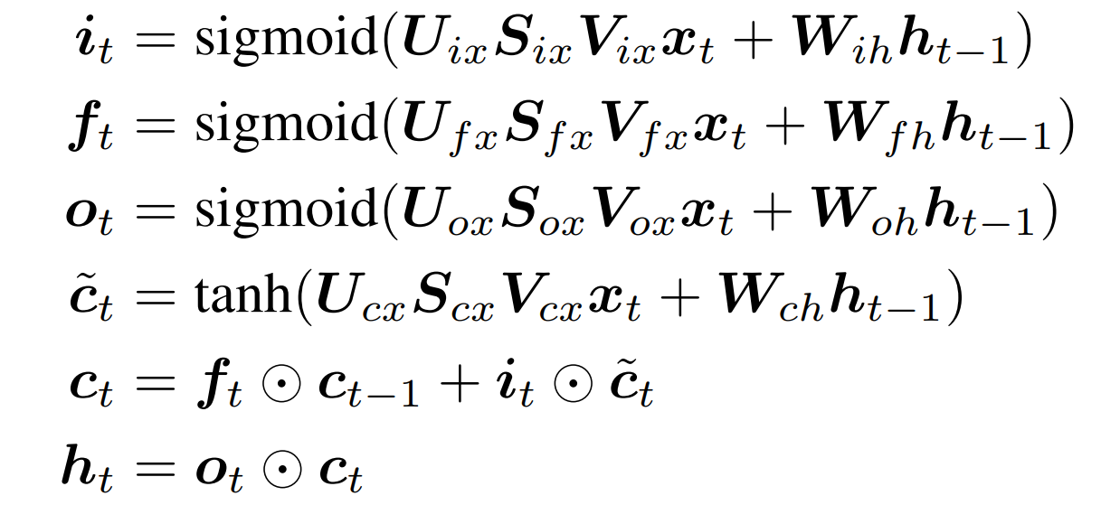
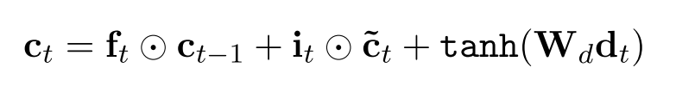
1. RNN
Notes:
Three components U, s, V, different style has different S

Slide 15
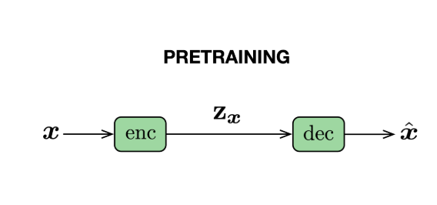
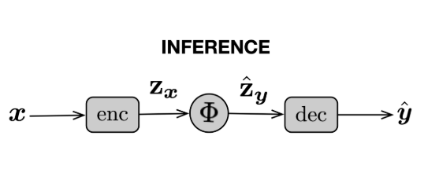
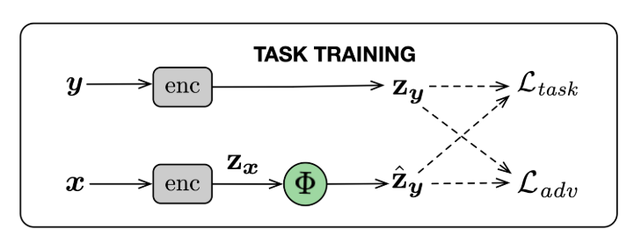
2. Pre-trained Language models
Dathathri et al. (2019), Plug and Play Autoencoders for Conditional Text Generation
Notes:
Previous method is hard to use in pre-trained language models

Slide 16
4. Output
X : source sequence
Y: target sequence
S: Condition attributes

Slide 17
1. Arithmetic or Linear Transform
$${\hat{o}}_{t}={[o}_{t};s]$$
$${\hat{o}}_{t}=o_{t} + s$$
$${\hat{o}}_{t}={tanh⁡(W_{1}o}_{t} + W_{2}s+b)$$
2. Attention
You can just use attention mechanism to adding information of conditions into the model. You can use it in encoder, generator, output layer or other parts.

Slide 18
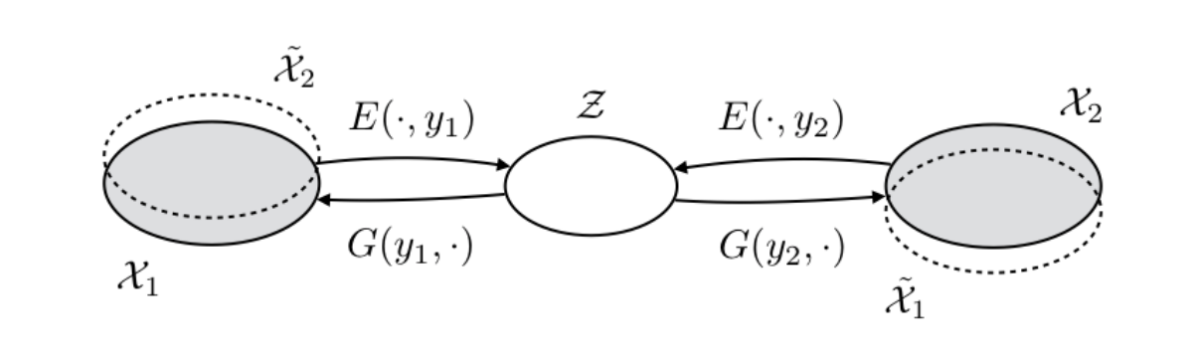
3.External Feedback
An adversarial loss to manipulate the latent space is used as an external feedback mechanism

Slide 19
Issues
1. Need to train different model for different tasks
Duan, et al. Pre-train and Plug-in: Flexible Conditional Text Generation with Variational Auto-Encoders, ACL 2020
2. Lack of parallel dataset
Mai, et al. Plug and Play Autoencoders for Conditional Text Generation, EMNLP 2020

Slide 20
Conclusion
Conditional text generation is widely used in real life. It’s an important part of generation task
There are a lot of techniques to solve such tasks
There still some issues in this tasks

Slide 21
Thanks

